Slide 1


Advanced JAVA Programming Unit 2: AWT and Swing
TE E&TE

Slide 2
Java AWT
Java AWT (Abstract Window Toolkit) is an API to develop Graphical User Interface (GUI) or windows-based applications in Java.
Java AWT components are platform-dependent i.e. components are displayed according to the view of operating system. AWT is heavy weight i.e. its components are using the resources of underlying operating system (OS).
The java.awt package provides classes for AWT API such as TextField, Label, TextArea, RadioButton, CheckBox, Choice, List etc.

Slide 3
Java AWT is Platform Dependent
Java AWT calls the native platform calls the native platform (operating systems) subroutine for creating API components like TextField, ChechBox, button, etc.
For example, an AWT GUI with components like TextField, label and button will have different look and feel for the different platforms like Windows, MAC OS, and Unix. The reason for this is the platforms have different view for their native components and AWT directly calls the native subroutine that creates those components.
In simple words, an AWT application will look like a windows application in Windows OS whereas it will look like a Mac application in the MAC OS.

Slide 4
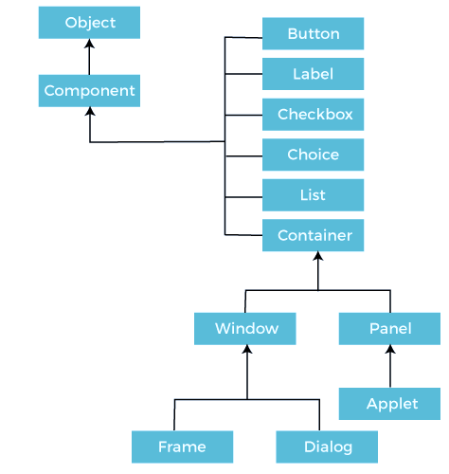
Java AWT Hierarchy

Slide 5
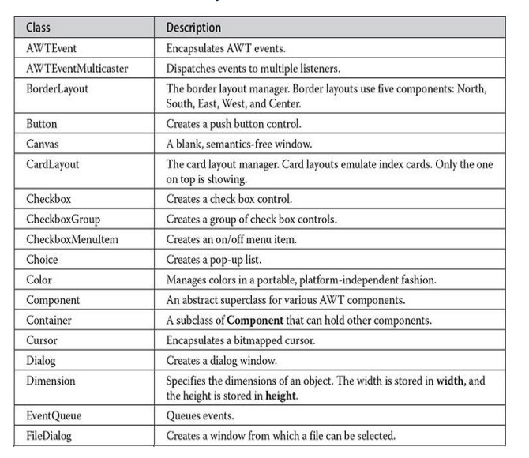

Slide 6
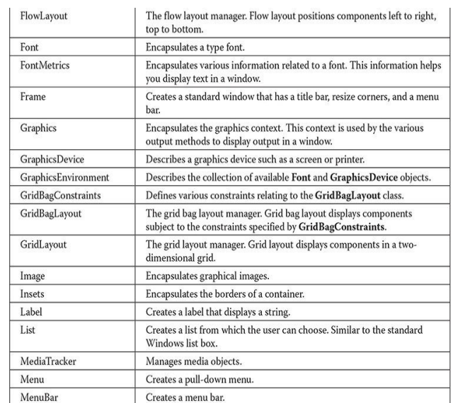

Slide 7
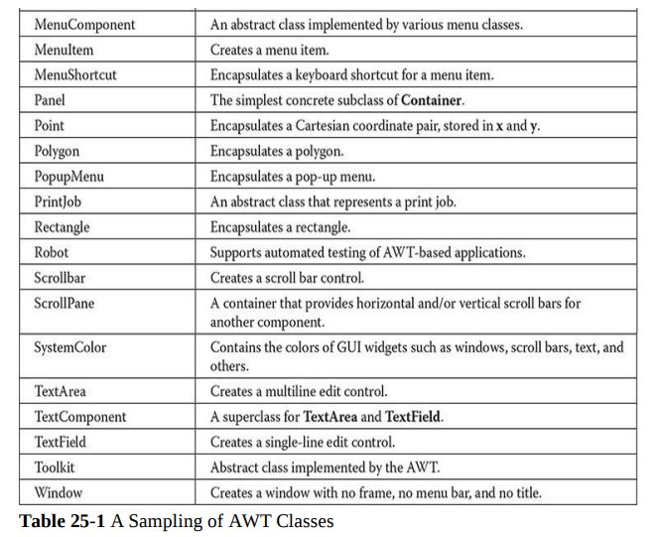

Slide 8
Component Class
The Component class is the superclass of all components.
A component class can be linked with a page, components of web applications. Component is the graphical representation of an Object.
Types of Components in Component Class
Container
Button
Label
Checkbox
Choice
List
All these components are present in java.awt package. We can import each of the components individually i.e., import java.awt.Button, import java.awt.Container etc.

Slide 9
Java AWT Controls
Container: The Container is a component in AWT that can contain another components like buttons, textfields, labels etc. The classes that extends Container class are known as container such as Frame, Dialog and Panel.
Panel: The Panel is the container that doesn't contain title bar and menu bars or border. It can have other components like button, textfield etc.
Window: The Window class creates a top level window. Top level object is not contained within any other object.
Generally, we would not create Window objects directly, instead we will use subclass of Window called Frame.
Frame: The Frame is the container that contain title bar and can have menu bars. It can have other components like button, textfield etc.

Slide 10
Useful Methods of Component Class
Method | Description
public void add(Component c) | Inserts a component on this component.
public void setSize(int width,int height) | Sets the size (width and height) of the component.
public void setLayout(LayoutManager m) | Defines the layout manager for the component.
public void setVisible(boolean status) | Sets the visibility of a component to visible or not. If it sets to true, then the component will be visible in the output else if it sets to false or not defined component won’t be visible in the output.

Slide 11
AWT UI Elements
Label - A Label object is a component for placing text in a container.
Button - This class creates a labeled button.
Check Box - A check box is a graphical component that can be in either an on (true) or off (false) state.
Check Box Group - The CheckboxGroup class is used to group the set of checkbox.
List - The List component presents the user with a scrolling list of text items.
Text Field - A TextField object a text component that allows for the editing of a single line of text.
Text Area - A TextArea object is a text component that allows for the editing of a multiple lines of text.
Choice - A Choice control is used to show pop up menu of choices. Selected choice is shown on the top of the menu.

Slide 12
AWT UI Elements
Canvas - A Canvas control represents a rectangular area where application can draw something or can receive inputs created by user.
Image - An Image control is superclass for all image classes representing graphical images.
Scroll Bar - A Scrollbar control represents a scroll bar component in order to enable user to select from range of values.
Dialog - A Dialog control represents a top-level window with a title and a border used to take some form of input from the user.
File Dialog - A FileDialog control represents a dialog window from which the user can select a file.

Slide 13
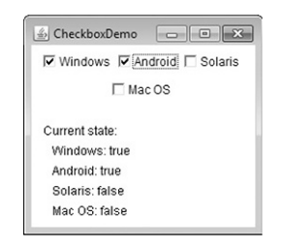
Checkbox
A check box is a control that is used to turn an option on or off.
It consists of a small box that can either contain a check mark or not.
There is a label associated with each check box that describes what
option the box represents.
You change the state of a check box by clicking on it.
Check boxes can be used individually or as part of a group.
Check boxes are objects of the Checkbox class.
Constructor | Description
Checkbox() | Create a checkbox with blank label and state is unchecked
Checkbox(String str) | Create a checkbox with string str label but state is unchecked
Checkbox(String str,Boolean on) | Create a checkbox with string str label and status is on (true/checked)

Slide 14
Checkbox
CheckBox Class Methods | Description
Boolean getState() | To retrieve the current state of the checkbox
Void setState(Boolean on) | Set the state of checkbox
String getLabel() | To retrieve the label of the checkbox
Void setLabel(String str) Set the label of checkbox
Event Handling | Description
itemEvent | Each time when checkbox selected or deselected,an itemEvent is create
ItemListenerInterface | To handle the event used ItemListener Interface
itemStateChanged(ItemEvent e) addItemListener(this) | Using this method handle the event of checkbox Add checkbox for Item event handling

Slide 15
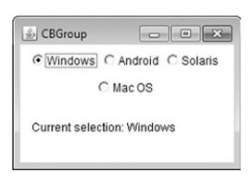
CheckboxGroup
Set of mutually exclusive check boxes in which one and only one check box in the group can be checked at any one time .
Check boxed are often called as radio buttons.
getSelectedCheckbox()
setSelectedCheckbox()
getLabel()
itemSateChanged(ItemEvent e);
addItemListener(this);

Slide 16
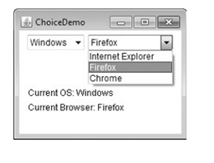
Choice Controls
Choice class is used to create a pop up list of items from which the user may choose.
When user clicks on it, the whole list of choices pops up and new selection can be made.
Each item in the list is string that appears as a let justified label in the order it is added to the choice object.
Add()
getSelectedItem()
getSelectedIndex()
String getItem(int index)
First item is at an index 0 . By default , the first item added to the list is selected.
itemSateChanged(ItemEvent e);
addItemListener(this);

Slide 17
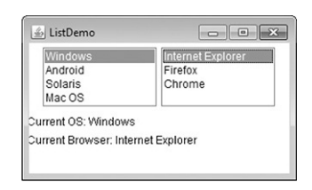
Lists
List class provides a compact, multiple choice, scrolling selection list.
List object can be constructed to show
any number of choices in the visible window
It can also allow multiple selections.
Constructor | Description
List() | That allows only one item to be selected at any one time
List(int numrows) | value of numRows specifies the number of entries in the list that will always be visible(others can be scrolled into view as needed).
List(int numrows, Boolean multiple select) | if multipleSelect is true, then the user may select two or more items at a time. If it is false, then only one item may be selected.

Slide 18
Lists
Add() :-add item to the list at the end
Add (String name, int index)
Indexing begins at zero (-1 to add item at last)
getSelectedItem() :- you can determine which item is
currently selected
getSelectedIndex()
String[] getSelectedItems()
int [] getSelectedIndexes()
getItem(index[i]);
First item is at an index 0 .
actionPerformed(ActionEvent e);
addActionListener(this);

Slide 19
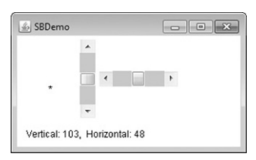
ScrollBar
Scroll bars are used to select continuous values between a specified minimum and maximum
Scroll bar may be oriented horizontally or vertically
Scroll bars are encapsulated by the Scrollbar class.
Constructor (from Scrollbar class) | Current value of scrollbar
Scrollbar() | int getValue():- current value of scrollbar
Scrollbar( int style) , style=ScrollBar.VERTICAL | void setValue(int new Value)
Scrollbar(int style, int initialvalue, int thumbSize, int min, int max) | int getMaximum() reterive the max and min int getMinimum() void setUnitIncrement(int newIncr) Void setBlockIncrement(int newIncr)

Slide 20
Scroll Bar Event Handling
Adjustment Event | Handle By
BLOCK_DECREMENT- page down event BLOCK_INCREMENT-page up event UNIT_INCREMENT-line up button in scroll bar has been pressed UNIT_DECREMENT-line down button in scroll bar has been pressed | AdjustmentListener AdjustmentEvent object getAdjustmentType()- to getting type of adjustment adjustmentValueChanged(AdjustmentEvent e)

Slide 21
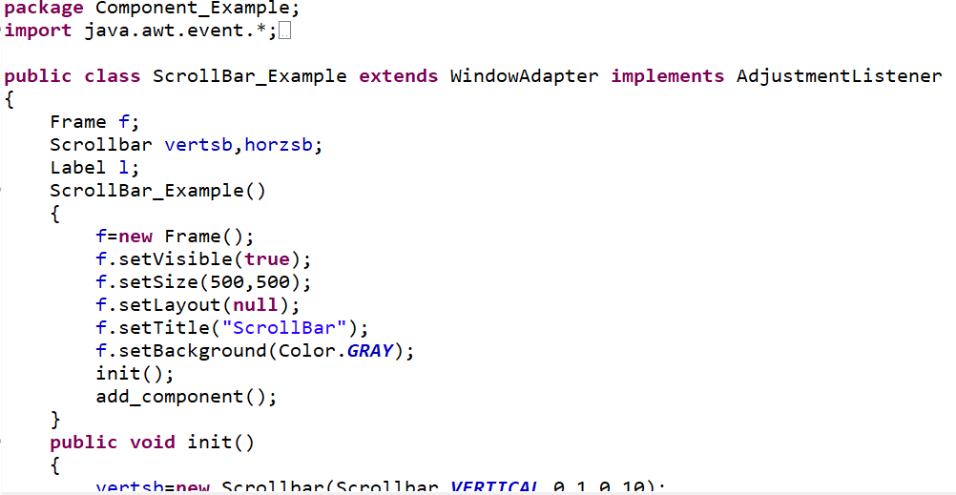

Slide 22
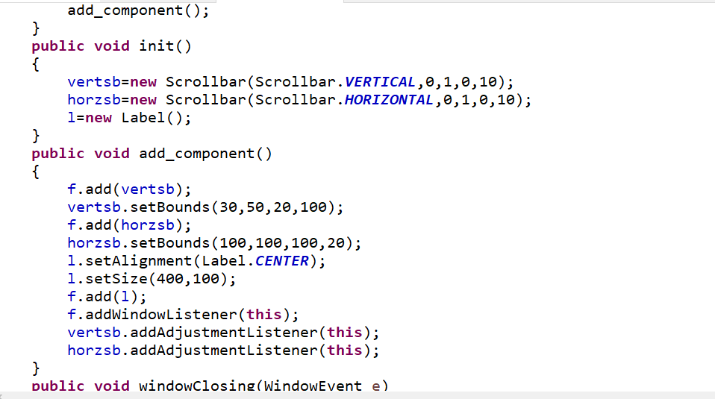

Slide 23
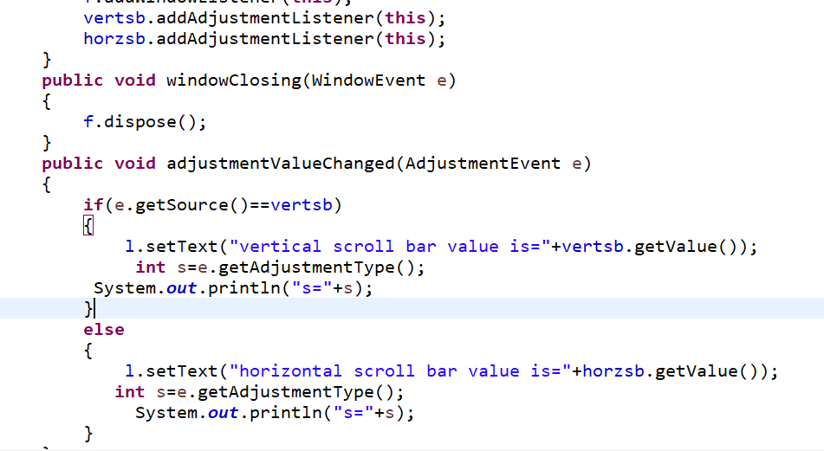

Slide 24
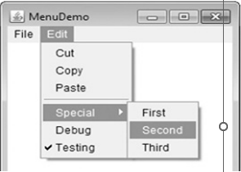
MenuBar, Menu and MenuItem
Top-level window can have a menu bar associated with it.
Menu bar displays a list of top-level menu choices.
Each choice is associated with a dropdown menu.
Concept implemented by MenuBar, Menu and MenuItem classes
In general, a menu bar contains one or more Menu objects.
Each Menu object contains a list of MenuItem objects.
To create a menu bar, first create an instance of MenuBar. This class defines only the default constructor.
create instances of Menu that will define the selections displayed on the bar.

Slide 25
MenuBar, Menu and MenuItem
Constructor | Description
Menu() | Create a menu on menubar without name
Menu(String Option name) | Create a menu with optionName it specifies the name of the menu selection
Menu(String optionName, boolean removable) | If removable is true, the menu can be removed and allowed to float free.
Event | Method
ActionEvent( ) | Item.addActionListener(this)
ActionEventListener | getActionCommand():- return item name which has selected
actionPerformed(ActionEvent e)

Slide 26
MenuBar, Menu and MenuItem
Method | Description
setEnabled( ) | disable or enable a menu item
isEnabled( ) | determine an item’s status
setLabel( ) getLabel( ) | change the name of a menu item retrieve the current name
Method | Description
add( ) | add the item to a Menu object by using add( )
MenuItem(String itemName) | Create menuitem itemName is the name shown in the menu,
MenuItem(String itemName, MenuShortcut keyAccel) | itemName is the name shown in the menu, and keyAccel is the menu shortcut for this item.

Slide 27
Dialogs
DialogBoxes:-
Types:-
1) Modal Dialog
2) Modeless Dialog
FileDialog:-
Constructor | Dialog(Frame parentWindow, Boolean mode)
 | Dialog (Frame parentWindow, String title, Boolean mode)
Constructor | FileDialog(Frame parent)
 | FileDialog(Frame parent, String boxname, int how) How is FileDialog.LOAD, FileDialog.SAVE
Method | String getDirectory()
 | String getFile()

Slide 28
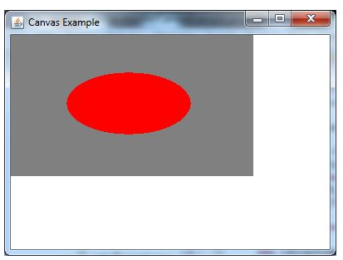
Canvas
Canvas class controls and represents a black rectangular area where the application can draw from the user.
It inherits the Component class
Sr. no. | Constructor | Description
1. | Canvas() | It constructs a new Canvas.
2. | Canvas(GraphicConfiguration config) | It constructs a new Canvas with the given Graphic Configuration object.

Slide 29
Layout Manager
Layout manager automatically arranges your components within a window by using some type of algorithm
Drawback of Manual Layout
Lay out manually it is very tedious for large no of components
Width and height overlapping
Layout manager is an instance of any class that implements the LayoutManager interface
Layout manager set by the setLayout() method
If no call to setLayout() then default layout manager is used.
Syntax :- void setLayout(LayoutManager layoutobj)
For manual positioning layoutobj is null
If you do this then manually set the position and shape of components by setBounds() method

Slide 30
Layout Manager :- FlowLayout
FlowLayout is the default layout manager
FlowLayout implements a simple layout style, which is similar to how words flow in a text editor.
Direction of the layout is by default left to right , top to bottom
That means components are placed line by line beginning at the upper left corner
Small spaces is left between each component, above and below as well as left and right
Constructor | Description
FlowLayout() | Create default layout, which centers components and leaves five pixels of space between each component.
FlowLayout(int how) | how each line is aligned
FlowLayout(int how, int horz int vert) | Specify the horizontal and vertical space left between components

Slide 31
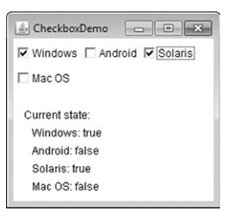
Layout Manager :- FlowLayout
Constructor | Description
FlowLayout() | Create default layout, which centers components and leaves five pixels of space between each component.
FlowLayout(int how) | how each line is aligned Valid values for how are FlowLayout.LEFT FlowLayout.CENTER FlowLayout.RIGHT FlowLayout.LEADING FlowLayout.TRAILING
FlowLayout(int how, int horz int vert) | Specify the horizontal and vertical space left between components

Slide 32
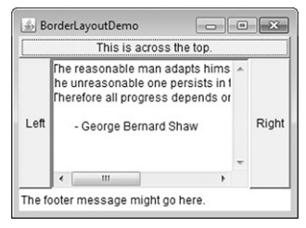
Layout Manager :- BorderLayout
BorderLayout class is implements a layout style that has four narrow, fixed width components at the edges and one large area in the center.
Four sides are referred to as North, South, East and West
Middle area is called as center
Constructor | Description
BorderLayout() | Create default layout with no gaps between components
BorderLayout(int hgap, int vgap) | Construct a border layout with the specified gaps between components

Slide 33
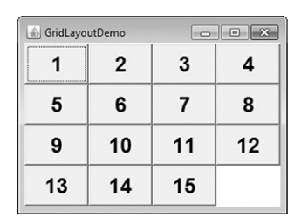
Layout Manager :- GridLayout
GridLayout lays out components in a two dimensional grid
Arranges components in a rectangular grid
When you instantiate a GridLayout, define the number of rows and columns
Constructor | Description
GridLayout() | Create single column grid layout
GridLayout(int numRows, int numColumns) | Create a grid layout with the specified number of rows and columns
GridLayout(int numRows, int numColumns, int horz,int vert) | Create a grid layout to specify the horizontal and vertical space left between the components in horzt and vert.

Slide 34
Layout Manager :- CardLayout
CardLayout arranges each component in the container as a card.
Only one card is visible at a time and the container acts as a stack of cards.
Constructor | Description
CardLayout() | Create default card layout
CardLayout(int horz, int vert) | Create a card layout with specify the horizontal and vertical space left between components in horz and vert

Slide 35
Layout Manager :- CardLayout
Commonly Used Methods of CardLayout Class
public void next(Container parent): is used to flip to the next card of the given container.
public void previous(Container parent): is used to flip to the previous card of the given container.
public void first(Container parent): is used to flip to the first card of the given container.
public void last(Container parent): is used to flip to the last card of the given container.
public void show(Container parent, String name): is used to flip to the specified card with the given name.

Slide 36
Java Event Handling
Event:
Change in the state of an object is known as event i.e., event describes the change in state of source.
Events are generated as result of user interaction with the graphical user interface components.
For example, clicking on a button, moving the mouse, entering a character through keyboard, selecting an item from list, scrolling the page are the activities that causes an event to happen.
Types of Events: The events can be broadly classified into two categories:
Foreground Events
Background Events

Slide 37
Types of Events
Foreground Events:
The events which require direct interaction of user.
They are generated as consequences of a person interacting with the graphical components in Graphical User Interface.
For example, clicking on a button, moving the mouse, entering a character through keyboard, selecting an item from list, scrolling the page etc.
Background Events:
The events that require the interaction of end user are known as background events.
Operating system interrupts, hardware or software failure, timer expires, an operation completion are the examples of background events.

Slide 38
Event Handling
Event Handling is the mechanism that controls the event and decides what should happen if an event occurs.
This mechanism have the code which is known as event handler that is executed when an event occurs.
Java Uses the Delegation Event Model to handle the events. This model defines the standard mechanism to generate and handle the events.
The Delegation Event Model has the following key participants namely:
Source
The source is an object on which event occurs.
Source is responsible for providing information of the occurred event to it's handler.

Slide 39
Event Handling
Listener:
It is also known as event handler.
Listener is responsible for generating response to an event.
From java implementation point of view the listener is also an object.
Listener waits until it receives an event.
Once the event is received, the listener process the event and then returns.

Slide 40
Steps in Event Handling
The User clicks the button, and the event is generated.
The object of concerned event class is created automatically and information about the source and the event get populated with in same object.
Event object is forwarded to the method of registered listener class.
The method is now gets executed and returns.

Slide 41
Java Adapter Classes
Java adapter classes provide the default implementation of listener interfaces.
The adapter classes are found in java.awt.event, and javax.swing.event packages.
Working with Color, and Font.
Working with Color:
Java supports color in a portable, device independent fashion.
The AWT color system allows you to specify any color you want.
Color is encapsulated by the Color class. The most used constructors are:
Color (int red, int green, int blue)
Color (int rgbValue)
Color (float red, float green, float blue)

Slide 42
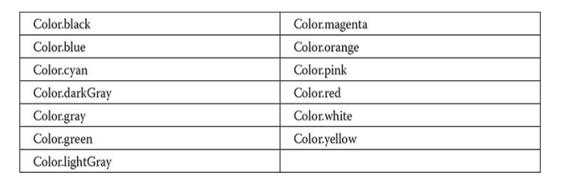

Slide 43
Working with Color
The first constructor takes three integers that specify the color as a mix of red, green, and blue.
These values must be between 0 and 255.
Example: new Color (255, 100, 100); // light red
The second color constructor takes a single integer that contains the mix of red, green, and blue packed into an integer.
The integer is organized with red in bits 16 to 23, green in bits 8 to 15, and blue in bits 0 to 7
Example: int newRed = (0xff000000 | (0xc0 << 16) | (0x00 << 8) | 0x00);
Color darkRed = new Color(newRed);
The final constructor, Color (float, float, float), takes three float values (between 0.0 and 1.0) that specifies the relative mix of red, green, and blue.

Slide 44
Setting the Current Graphics Color
By default, graphics objects are drawn in the current foreground color.
We can change this color by calling the Graphics method setColor() - void setColor (Color newColor);
Here, newColor specifies the new drawing color.
We can obtain the current color by calling getColor() - Color getColor();
Working with Fonts:
The AWT supports multiple type fonts.
Fonts are encapsulated by the Font class.

Slide 45
Creating and Selecting a Font
To select a new font, you must first construct a Font object that describes that font.
One Font constructor has this general form - Font(String fontName, int fontStyle, int pointSize);
Here, fontName specifies the name of the desired font.
To use a font that you have created, you must select it using setFont(), which is defined by Component.
It has this general form - void setFont(Font fontObj);
Here, fontObj is the object that contains the desired font.

Slide 46
Java AWT Examples
To create simple AWT example, you need a frame. There are two ways to create a GUI using Frame in AWT.
By extending Frame class (inheritance)
By creating the object of Frame class (association)

Slide 47
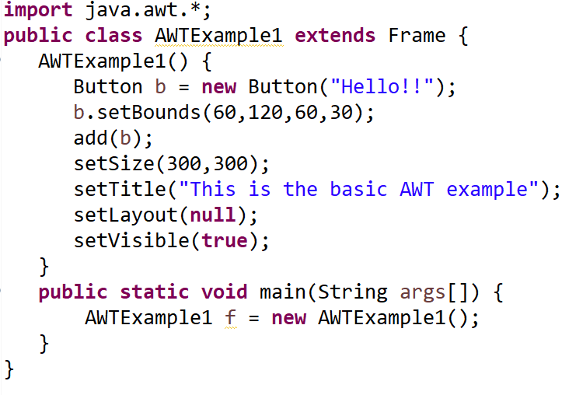
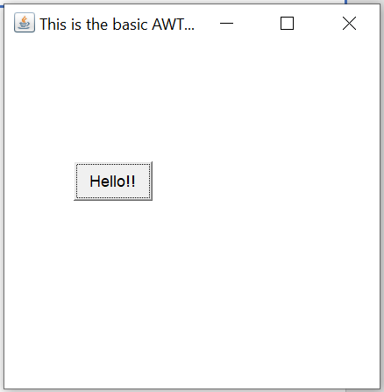
AWT Example by Inheritance

Slide 48
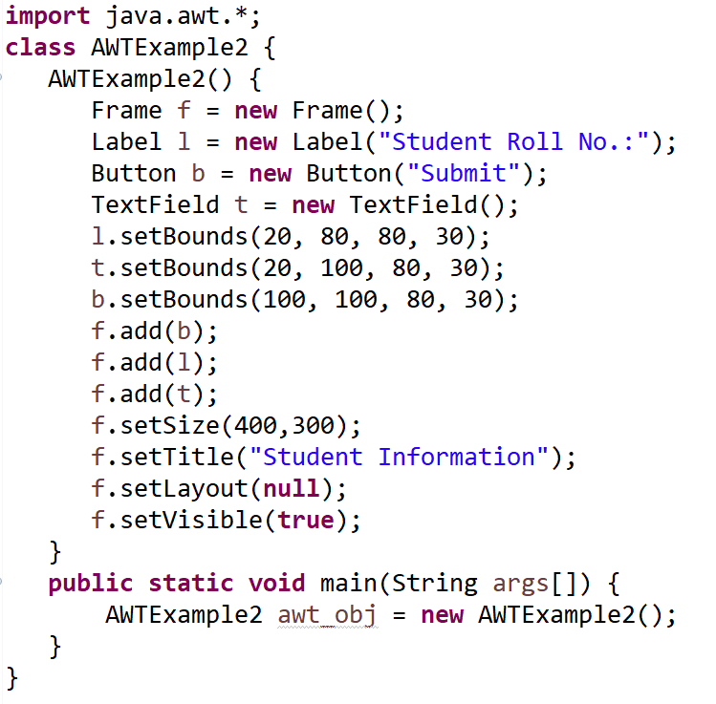
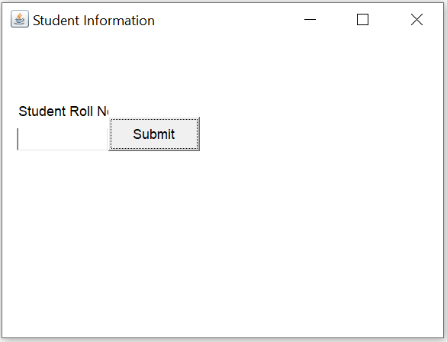
AWT Example by Association

Slide 49
Swing Package
Swing is a Set of API (API- Set of Classes and Interfaces).
Swing is Provided to Design a Graphical User Interfaces.
Swing is an Extension library to the AWT (Abstract Window Toolkit).
Includes New and improved Components that have been enhancing the looks and Functionality of GUIs.
Swing can be used to build (Develop) the Standalone swing GUI Apps, Servlets And Applets.
It Employs model/view design architecture.
Swing is more portable and more flexible than AWT, the Swing is built on top of the AWT.
Swing is entirely written in Java.
Java Swing Components are Platform-independent and the Swing Components are lightweight.
Swing Supports Pluggable look and feels and Swing provides more powerful components such as tables, lists, Scrollpanes, Colourchooser, tabbedpane, etc.

Slide 50
Features of Swing Class
Pluggable look and feel
Uses MVC architecture
Lightweight Components
Platform Independent
Advance features such as JTable, JTabbedPane, JScollPane etc
Java is a platform-independent language and runs on any client machine, the GUI look and feel, owned and delivered by a platform specific O/S, simply does not affect an application’s GUI constructed using Swing components.

Slide 51
Lightweight Components: Starting with the JDK 1.1, its AWT supported lightweight component development. For a component to qualify as lightweight, it must not depend on any non-Java [O/s based) system classes. Swing components have their own view supported by Java’s look and feel classes.
Pluggable Look and Feel: This feature enables the user to switch the look and feel of Swing components without restarting an application. The Swing library supports components look and feel that remains the same across all platforms wherever the program runs. The Swing library provides an API that gives real flexibility in determining the look and feel of the GUI of an application

Slide 52
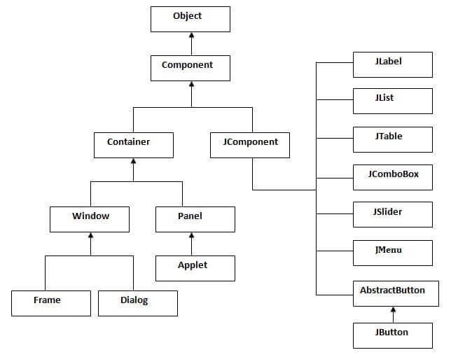
Swing Classes Hierarchy

Slide 53
AWT vs Swing
Java AWT | Java Swing
AWT components are heavyweight. | Swing components are lightweight.
AWT doesn't support pluggable look and feel. | Swing supports pluggable look and feel.
AWT provides less components than Swing. | Swing provides more powerful components such as tables, lists, scrollpanes, colorchooser, tabbedpane etc.
AWT doesn't follow MVC (Model View Controller) where model represents data, view represents presentation and controller acts as an interface between model and view. | Swing follows MVC.

Slide 54
Java Swing Examples
There are two ways to create a frame:
By creating the object of Frame class (Association)
By extending Frame class (Inheritance)

Slide 55
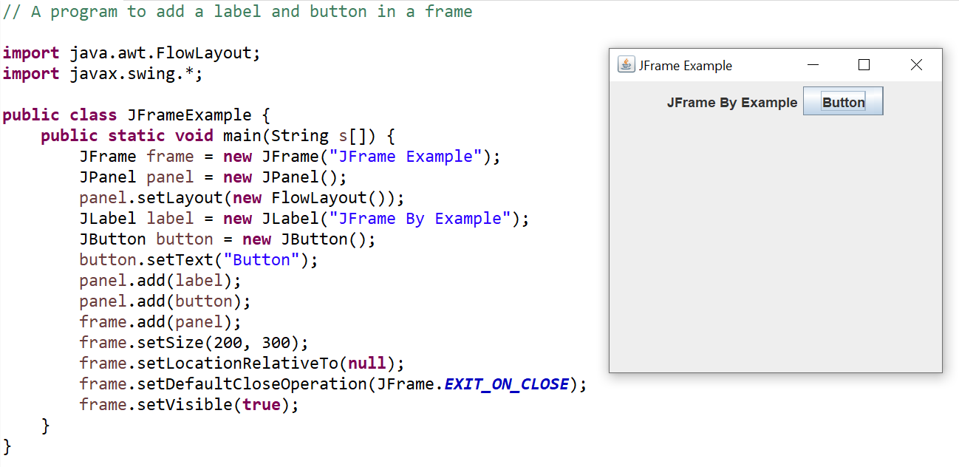
JFrame Example

Slide 56
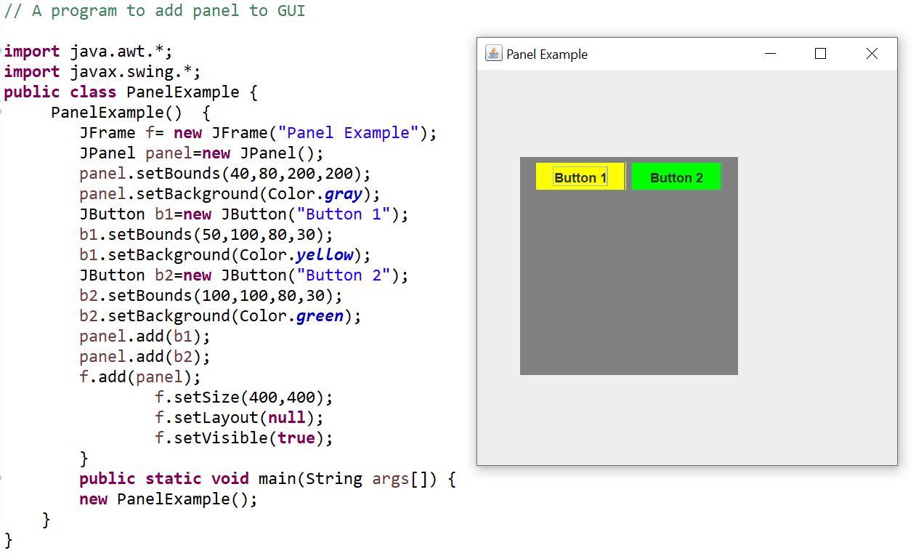
JPanel Example

Slide 57
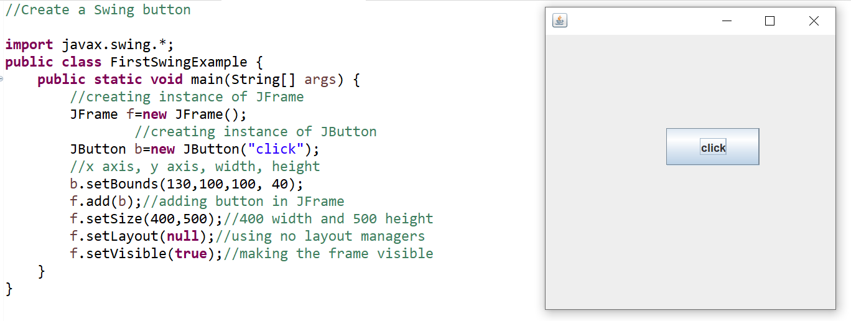
Swing Example

Slide 58
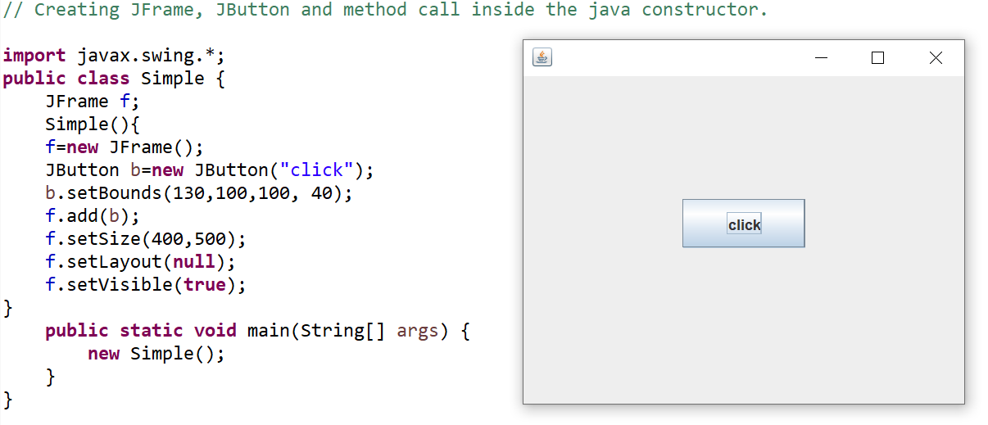
JFrame and JButton in Constructor

Slide 59
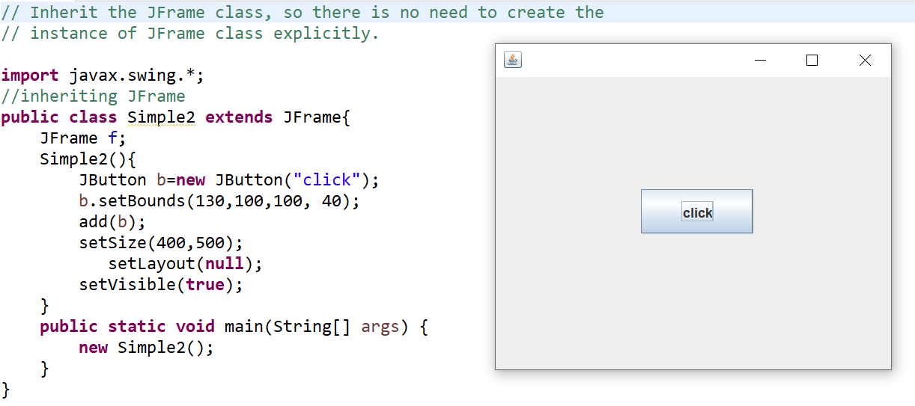
Inheriting JFrame Class

Slide 60
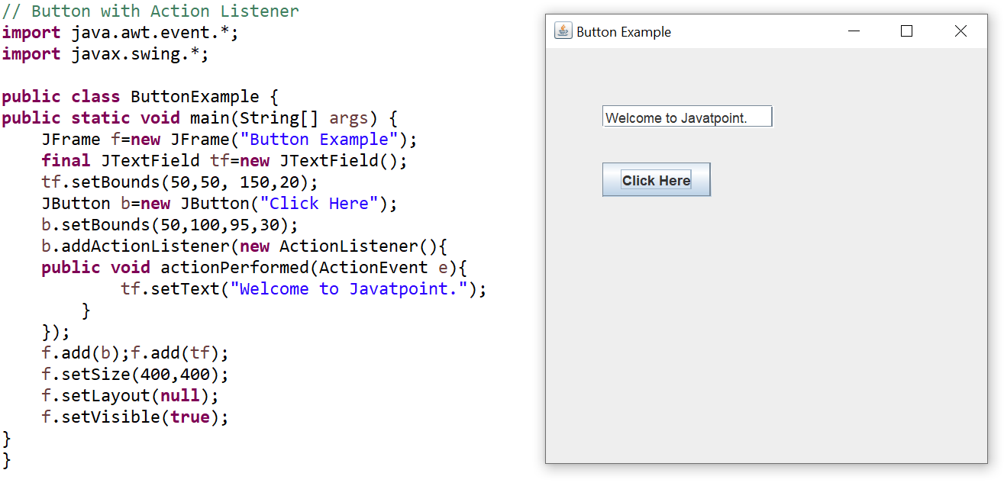
JButton Example

Slide 61
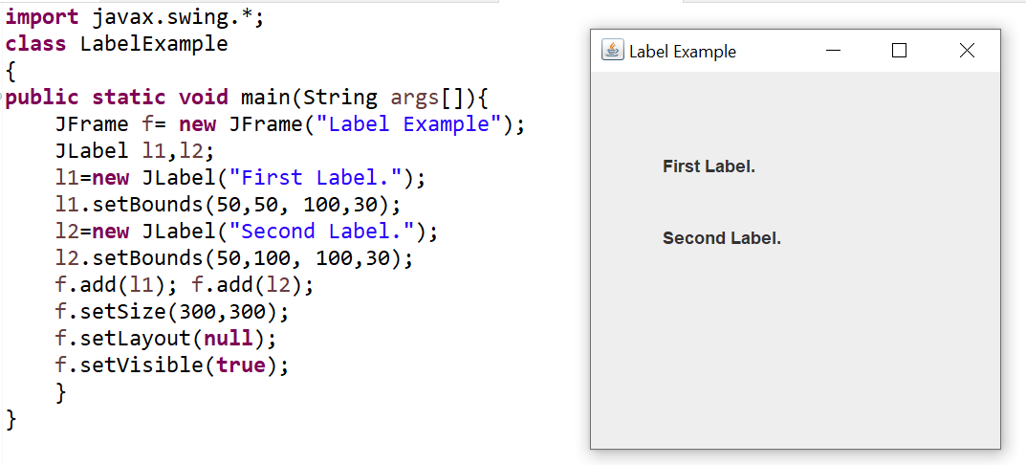
JLabel Example

Slide 62
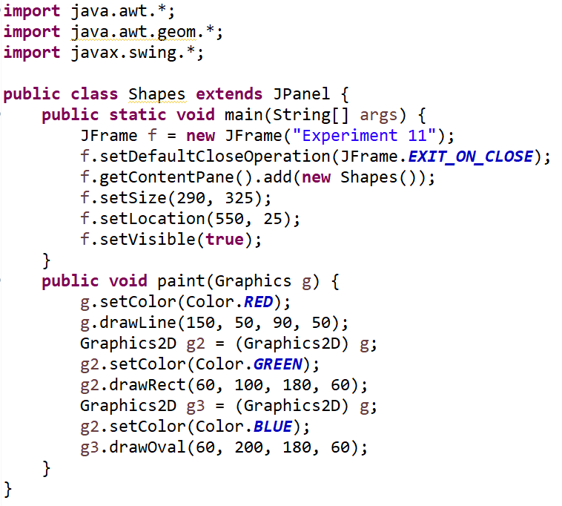
Drawing Geometrical Shapes

Slide 63
Adapter Classes
Java adapter classes provide the default implementation of listener interfaces.
If you inherit the adapter class, you will not be forced to provide the implementation of all the methods of listener interfaces. So it saves code.
Advantages of Adapter Classes
It assists the unrelated classes to work combinedly.
It provides ways to use classes in different ways.
It increases the transparency of classes.
It provides a pluggable kit for developing an application.
It increases the reusability of the class.
The adapter classes are found in java.awt.event, java.awt.dnd and javax.swing.event packages.

Slide 64
Adapter Classes
java.awt.event Adapter classes
Adapter class | Listener interface
WindowAdapter | WindowListener
KeyAdapter | KeyListener
MouseAdapter | MouseListener
MouseMotionAdapter | MouseMotionListener
FocusAdapter | FocusListener
ComponentAdapter | ComponentListener
ContainerAdapter | ContainerListener
HierarchyBoundsAdapter | HierarchyBoundsListener

Slide 65
java.awt.dnd Adapter classes
Adapter class | Listener interface
DragSourceAdapter | DragSourceListener
DragTargetAdapter | DragTargetListener
javax.swing.event Adapter classes
Adapter class | Listener interface
MouseInputAdapter | MouseInputListener
InternalFrameAdapter | InternalFrameListener

Slide 66
Inner Class
Java inner class or nested class is a class that is declared inside the class or interface.
We use inner classes to logically group classes and interfaces in one place to be more readable and maintainable.
Additionally, it can access all the members of the outer class, including private data members and methods.
Syntax of Inner class
class Java_Outer_class{
//code
class Java_Inner_class{
//code
}
}

Slide 67
Inner Class
Advantage of Java inner classes
Nested classes represent a particular type of relationship that is it can access all the members (data members and methods) of the outer class, including private.
Nested classes are used to develop more readable and maintainable code because it logically group classes and interfaces in one place only.
Code Optimization: It requires less code to write.

Slide 68
Inner Class
Types of Inner Class
1) Member Inner Class
2) Static Inner Class
3) Anonymous Inner Class

Slide 69
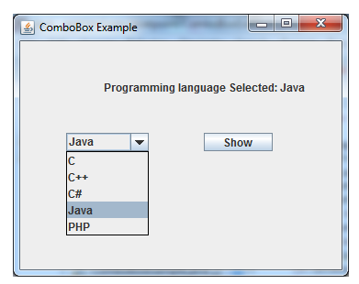
Swing Components:- JCombobox
Swing provides a combo box (a combination of a text field and a drop-down list) through the JComboBox class.
A combo box normally displays one entry, but it will also display a drop-down list that allows a user to select a different entry.
public class JComboBox extends Jcomponent
Constructor | Description
JComboBox() | Creates a JComboBox with a default data model.
JComboBox(Object[] items) | Creates a JComboBox that contains the elements in the specified array.

Slide 70
JCombobox
Methods | Description
void addItem(Object anObject) | It is used to add an item to the item list.
void removeItem(Object anObject) | It is used to delete an item to the item list.
void removeAllItems() | It is used to remove all the items from the list.
void setEditable(boolean b) | It is used to determine whether the JComboBox is editable.
void addActionListener(ActionListener a) | It is used to add the ActionListener.
Int getSelectedIndex() | Return an integer specifying the currently selected list item, where 0 specifies the first item in the list; or -1 if no item is selected or if the currently selected item is not in the list

Slide 71
Methods | Description
Object.getItemAt(int index) | Returns the list item at the specified index. If index is out of range (less than zero or greater than or equal to size) it will return null

Slide 72
JTable
The JTable class is used to display data in tabular form.
It is a component that displays rows and columns of data.
You can drag the cursor on column boundaries to resize columns.
You can also drag a column to a new position.
Depending on its configuration, it is also possible to select a row, column, or cell within the table, and to change the data within a cell.
Constructor | Description
JTable() | Creates a table with empty cells.
JTable(Object[][] rows, Object[] columns) | Creates a table with the specified data.

Slide 73
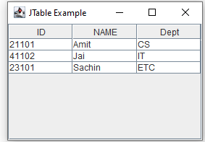
JTable

Slide 74
JTabbedPane
JTabbedPane encapsulates a tabbed pane.
It manages a set of components by linking them with tabs.
Selecting a tab causes the component associated with that tab to come to the forefront.
Tabbed panes are very common in the modern GUI, and you have no doubt used them many times.
Constructor | Description
JTabbedPane() | Creates an empty TabbedPane with a default tab placement of JTabbedPane.Top.
JTabbedPane(int tabPlacement) | Creates an empty TabbedPane with a specified tab placement.
JTabbedPane(int tabPlacement, int tabLayoutPolicy) | Creates an empty TabbedPane with a specified tab placement and tab layout policy.

Slide 75
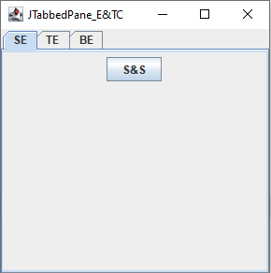
JTabbedPane
Procedure to hold the component in the tab
1) Create an instance of JTabbedPane
2) Add each tab calling by addTab()
3) Add the tabbed pane to content pane
Tabs are added by calling addTab()
E.g. void addTab(String name, Component comp);
Here name is name of the tab and comp is the specific component that should be added to the tab

Slide 76
JScrollPane
JScrollPane is a lightweight container that automatically handles the scrolling of another component.
When screen size is limited, we use a scroll pane to display a large component or a component whose size can change dynamically.
The viewable area of a scroll pane is called the viewport.
It is a window in which the component being scrolled is displayed.
In its default behavior, a JScrollPane will dynamically add or remove a scroll bar as needed. For example, if the component is taller than the viewport, a vertical scroll bar is added. If the component will completely fit within the viewport, the scroll bars are removed.
JScrollPane defines several constructors. The one used is shown here: JScrollPane(Component comp)

Slide 77
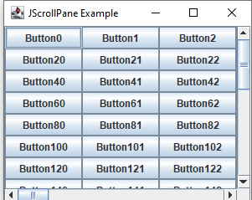
JScrollPane
Steps to follow to use a scroll pane:
1. Create the component to be scrolled.
2. Create an instance of JScrollPane, passing to it the object to scroll.
3. Add the scroll pane to the content pane.

Slide 78
Tree
A tree is a component that presents a hierarchical view of data.
The user has the ability to expand or collapse individual subtrees in this display.
Trees are implemented in Swing by the JTree class.
A sampling of its constructors are
JTree(Object obj [ ])
JTree(Vector v)
JTree(TreeNode tn)

Slide 79
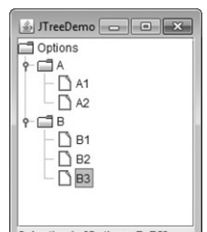
JTree does not provide any scrolling capabilities of its own.
Instead, a JTree is typically placed within a JScrollPane.
This way, a large tree can be scrolled through a smaller viewport.
Here are the steps to follow to use a tree:
1. Create an instance of JTree.
2. Create a JScrollPane and specify the tree as the object to be scrolled.
3. Add the tree to the scroll pane.
4. Add the scroll pane to the content pane

Slide 80
The TreeNode interface declares methods that obtain information about a tree node.
For example, it is possible to obtain a reference to the parent node or an enumeration of the child nodes.
The MutableTreeNode interface extends TreeNode.
It declares methods that can insert and remove child nodes or change the parent node.
The DefaultMutableTreeNode class implements the MutableTreeNode interface.
It represents a node in a tree.
One of its constructors is shown here: DefaultMutableTreeNode(Object obj) Here, obj is the object to be enclosed in this tree node.
The new tree node doesn’t have a parent or children.
To create a hierarchy of tree nodes, the add( ) method of DefaultMutableTreeNode can be used.
Its signature is shown here: void add(MutableTreeNode child) Here, child is a mutable tree node that is to be added as a child to the current node.

Slide 81
References
E Balagurusamy, “Programming with JAVA”, Tata McGraw Hill, 6th Edition.
Herbert Schildt, “Java: The complete reference”, Tata McGraw Hill, 7th Edition.
https://www.tutorialspoint.com
https://www.geeksforgeeks.org
https://www.javatpoint.com/
Online Resources

